Slide 1
Sandbox
Folienmaster
Nicolas Durant, David Halletz, Benjamin Hauck, Marita Pastore, Daniel Schneider

Slide 2
Farbschema

Slide 3
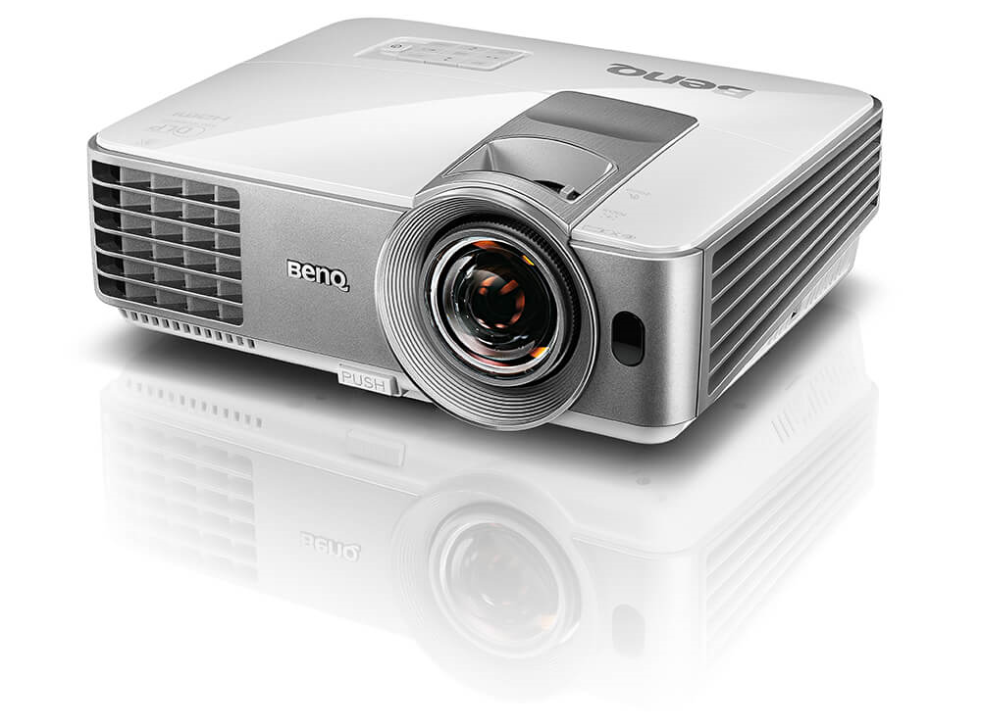
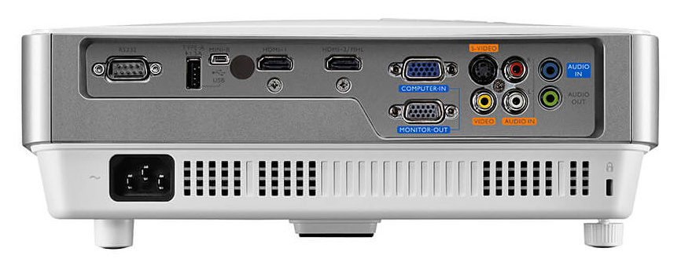
Beamer - BenQ MS630ST
Projection System | DLP
Resolution | SVGA(800x600) VGA(640 x 480) to UXGA(1600 x 1200)
Brightness | 3200 ANSI lumens
Contrast Ratio | 13000:1
Display Color | 30 Bits (1,07 billion colors)
Native Aspect Ratio | Native 4:3 (5 aspect ratio selectable)
Light Source | Lamp
Light Source Wattage | 196W
Light Source life | 4500/6000/6500/10000 Hours
Acoustic Noise | 33/28 dBA (normal/eco)
Operating Temperature | 0~40℃
Net Weight | ~2.6 kg

Slide 4
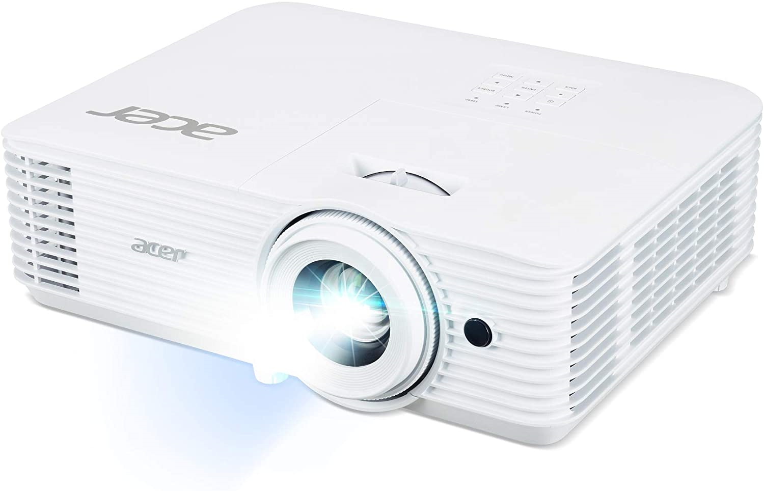
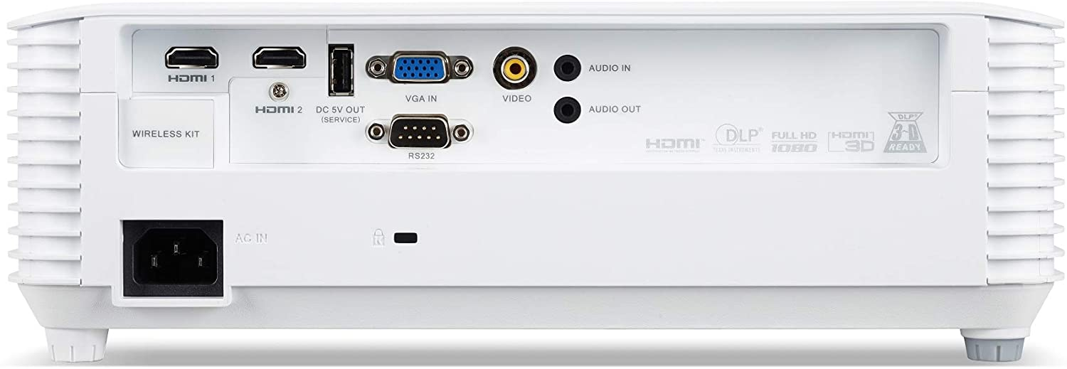
Beamer - Acer H6541BDi
Projection System | DLP
Resolution | 1920 x 1080 (nativ), 1920 x 1200
Brightness | 4000 lumens
Contrast Ratio | 10000:1
Display Color | 30 Bits (1,07 billion colors)
Native Aspect Ratio | Native 16:9, 4:3
Light Source | Lamp
Light Source Wattage | 250W
Light Source life | 5000/10000/12000
Acoustic Noise | 36/27 dBA (normal/eco)
Operating Temperature | 0~40℃
Net Weight | ~2.9 kg
Min / Max Dist | 1 m / 10 m
Costs | 555,00€ (Amazon)

Slide 5
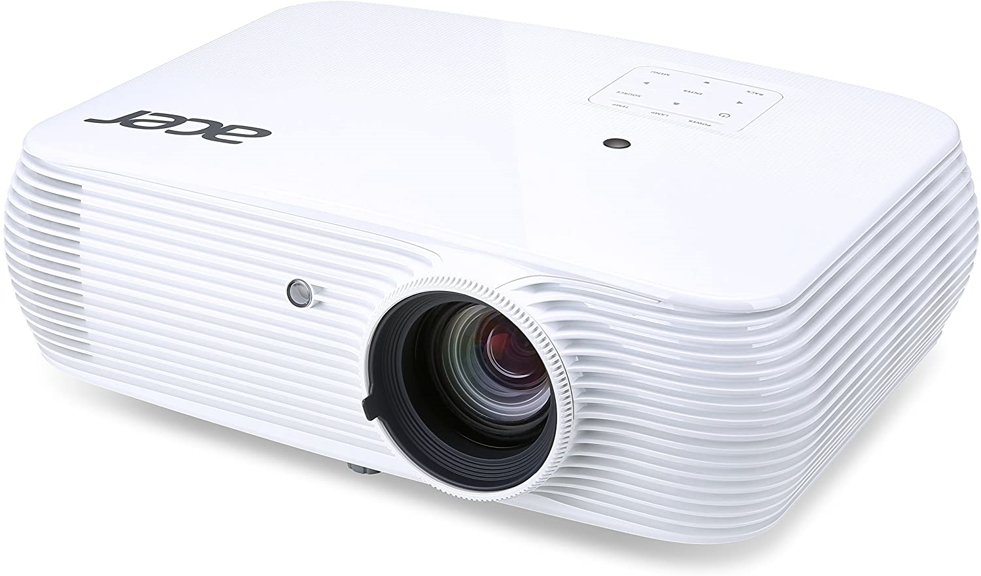
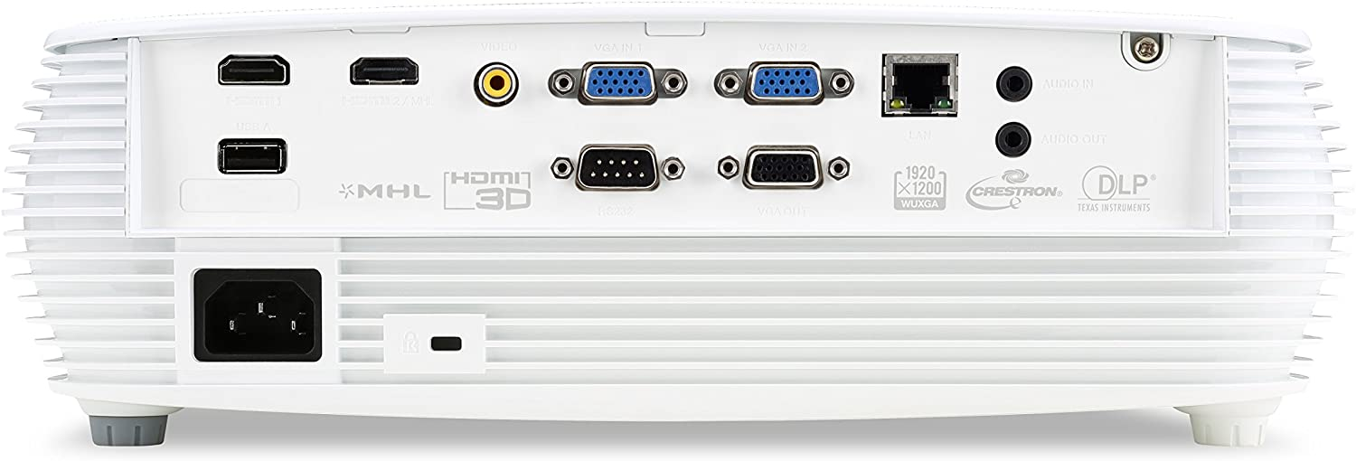
Beamer - Acer P5630
Projection System | DLP
Resolution | 1920 x 1200 (nativ), 1920 x 1200
Brightness | 4000 lumens
Contrast Ratio | 20000:1
Display Color | 30 Bits (1,07 billion colors)
Native Aspect Ratio | Native 16:10, 16:9, 4:3
Light Source | Lamp
Light Source Wattage | 240W
Light Source life | 4000/10000/15000
Acoustic Noise | 31/24 dBA (normal/eco)
Operating Temperature | 0~40℃
Net Weight | ~2.73 kg
Min / Max Dist | 1 m / 7,30 m
Costs | 775,90€ (Amazon)

Slide 6
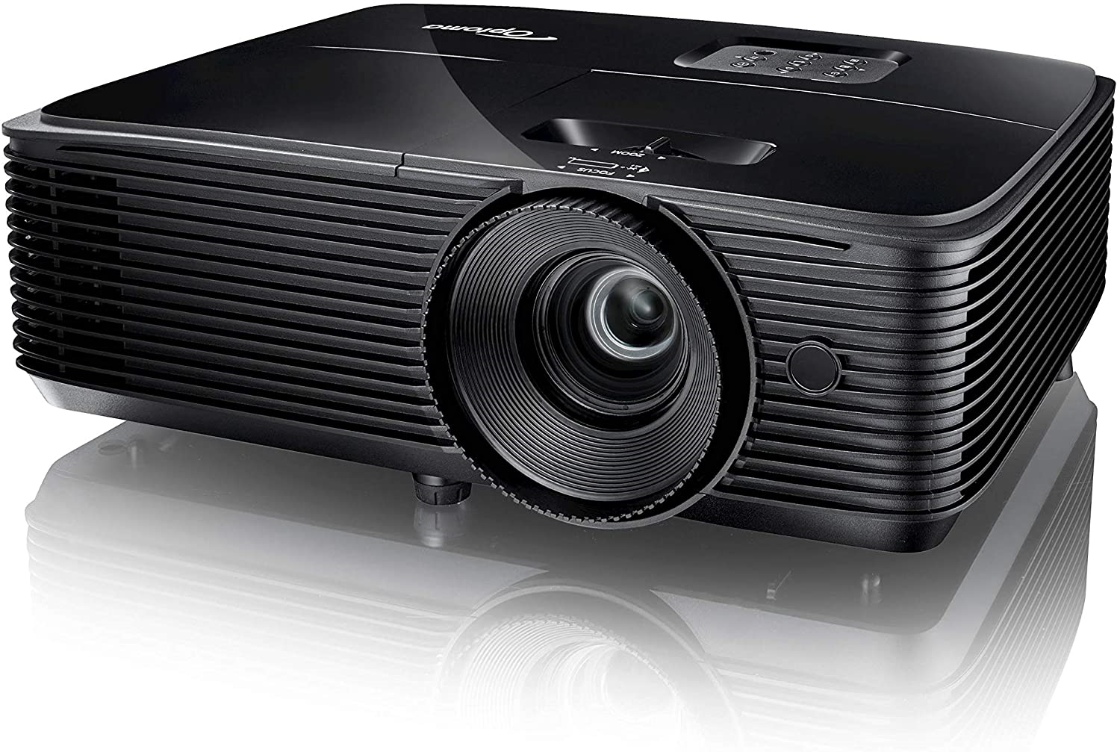
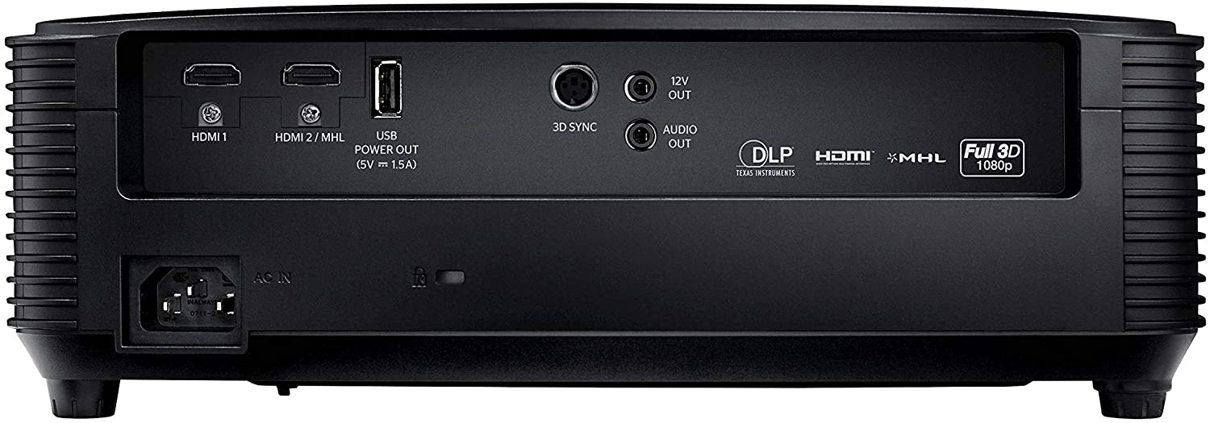
Beamer - Optoma HD144X
Projection System | DLP
Resolution | 1920 x 1080 (nativ)
Brightness | 3400 lumens
Contrast Ratio | 23000:1
Display Color | -
Native Aspect Ratio | Native 16:9, 4:3
Light Source | Lamp
Light Source Wattage | 240W
Light Source life | 3500/12000/10000
Acoustic Noise | 27/25 dBA (normal/eco)
Operating Temperature | 5~40℃
Net Weight | ~2.87 kg
Min / Max Dist | 1 m / 9,80 m
Costs | 469,00€ (Amazon)

Slide 7
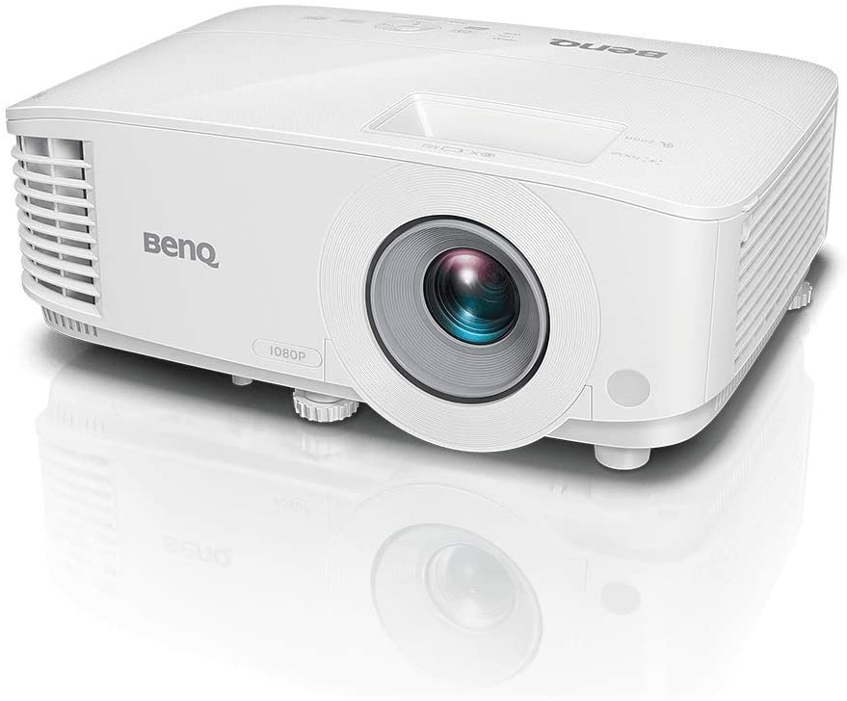
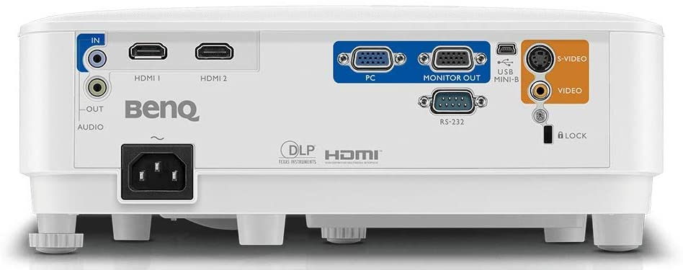
Beamer - BenQ TH550
Projection System | DLP
Resolution | 1920 x 1080 (nativ), 1920 x 1200 max
Brightness | 3500 lumens
Contrast Ratio | 20000:1
Display Color | 30 Bits (1,07 billion colors)
Native Aspect Ratio | Native 16:9, andere wählbar
Light Source | Lamp
Light Source Wattage | 200W
Light Source life | 5000/10000/15000
Acoustic Noise | 33/29 dBA (normal/eco)
Operating Temperature | 0~40℃
Net Weight | ~2.3 kg
Min / Max Dist | - (Schätzung: min 1m)
Costs | 661,20€ (Amazon)

Slide 8
Beamer - Vergleich
Beschreibung | BenQ MS630ST | Acer H6541BDi | Acer P5630 | Optoma HD144X | BenQ TH550
Projection System | DLP | DLP | DLP | DLP | DLP
Resolution | SVGA(800x600) VGA(640 x 480) to UXGA(1600 x 1200) | 1920 x 1080 (nativ), 1920 x 1200 (max) | 1920 x 1200 (nativ), 1920 x 1200 (max) | 1920 x 1080 (nativ) | 1920 x 1080 (nativ), 1920 x 1200 max
Brightness | 3200 ANSI lumens | 4000 lumens | 4000 lumens | 3400 lumens | 3500 lumens
Contrast Ratio | 13000:1 | 10000:1 | 20000:1 | 23000:1 | 20000:1
Display Color | 30 Bits (1,07 billion colors) | 30 Bits (1,07 billion colors) | 30 Bits (1,07 billion colors) | - | 30 Bits (1,07 billion colors)
Native Aspect Ratio | Native 4:3 (5 aspect ratio selectable) | Native 16:9, 4:3 | Native 16:10, 16:9, 4:3 | Native 16:9, 4:3 | Native 16:9, andere wählbar
Light Source | Lamp | Lamp | Lamp | Lamp | Lamp
Light Source Wattage | 196W | 250W | 240W | 240W | 200W
Light Source life | 4500/6000/6500/10000 Hours | 5000/10000/12000 | 4000/10000/15000 | 3500/12000/10000 | 5000/10000/15000
Acoustic Noise | 33/28 dBA (normal/eco) | 36/27 dBA (normal/eco) | 31/24 dBA (normal/eco) | 27/25 dBA (normal/eco) | 33/29 dBA (normal/eco)
Operating Temperature | 0~40℃ | 0~40℃ | 0~40℃ | 5~40℃ | 0~40℃
Net Weight | ~2.6 kg | ~2.9 kg | ~2.73 kg | ~2.87 kg | ~2.3 kg
Min / Max Dist | - | 1 m / 10 m | 1 m / 7,30 m | 1 m / 9,80 m | (Schätzung: min 1m)
Costs | - | 555,00€ (Amazon) | 775,90€ (Amazon) | 469,00€ (Amazon) | 661,20€ (Amazon)

Slide 9
Projektstand - Unity
Startschwierigkeiten:
Projekt läuft nicht richtig am Sandkasten (Auflösung, Einstellungen, Unity Version)
Projektstand aus altem Repo nicht automatisch lauffähig
Keine Dokumentation oder Anleitung zur Inbetriebnahme
Lösung:
Trial and Error Inbetriebnahme mit Import in LTS Version von Unity (2019.4.12f1) und Nachinstallieren nötiger Zusatzprogramme
Erstellen einer Anleitung zur Inbetriebnahme

